Slide 1

Joint Special Operations University
CH (MAJ) Ham, CH (MAJ) Knoedler, CH (CPT) Leonard & CH (MAJ-P) Ricci
Suicide Prevention and Postvention
Command Briefing
Unclassified
Notes:
TEMPLATE ONLY – SUGGESTED IDEA OF PPT

Slide 2


Overview
1: Suicide Theory
2: Suicide Stigmatisms
3: ASIST Model
4: Postvention
Notes:
TEMPLATE ONLY – SUGGESTED IDEA OF PPT

Slide 3
Suicide Theory
Thomas Joiner’s Theory of Suicide
  Two psychological experiences
    Perception
    Social Connection
Notes:
TEMPLATE ONLY – SUGGESTED IDEA OF PPT

Slide 4
Stigmatisms
Suicide Stigmatisms
RAND Mental Health Stigma in the Military
  Public Context
  Institutional Context
  Social Context
  Individual Context
  Impacts
Notes:
TEMPLATE ONLY – SUGGESTED IDEA OF PPT

Slide 5
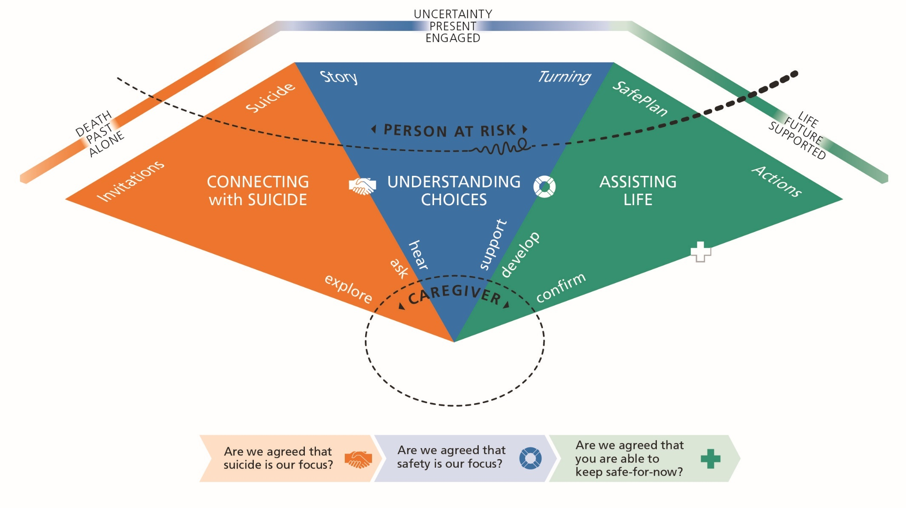
Assist & Models
Assist Model
Notes:
TEMPLATE ONLY – SUGGESTED IDEA OF PPT

Slide 6
Postvention
Postvention (1)
Intervention after a suicide
  Purpose of a postvention
  Groups affected
  Long-term plan
Notes:
TEMPLATE ONLY – SUGGESTED IDEA OF PPT

Slide 7
Postvention
Postvention (2)
What the Chaplain brings to the fight.
Month 1
Notification
Memorial service/ceremony
Spiritual support
Emotional support
Debrief
Grief counseling
Retreat for affected individuals
Bonfire
Month 2-3
Spiritual support
Emotional support
Grief counseling
Retreat for affected individuals
Bonfire
Suicide intervention training
ACE/ASIST
Long-term
Spiritual support
Emotional support
Grief counseling
Suicide workshops (ASIST T4T)
IMMEDIATE HELP HEALING HELPING OTHERS
Notes:
TEMPLATE ONLY – SUGGESTED IDEA OF PPT

Slide 8
Conclusion
Questions?
Notes:
TEMPLATE ONLY – SUGGESTED IDEA OF PPT

